Slide 1


CNPC Niger Petroleum S.A.
Computer Basics
CNPC Niger Petroleum S.A. CNPC Global Solutions Co. Ltd

Slide 2

Training Agenda
Lecture 1 : Hardware Basics, Outlook & MS Word
Lecture 2 : MS Excel, PowerPoint & ERP

Slide 3

Training Objectives
After finalizing this training you should be able to
Computer Hardware: Identify components, connect peripherals, and perform basic troubleshooting.
Excel: Use essential formulas, sort/filter data, and create basic charts.
PowerPoint: Create clean, professional slides and insert objects (images, charts).
Word: Apply consistent formatting (styles, headers) and use Track Changes.
Outlook: Write professional emails, organize their inbox, and manage their calendar.
ERP: Define what an ERP system is and explain its purpose in the business.

Slide 4

Test your Knowledge
Please scan the QR code here or go to the below website:
https://afathelbab.github.io/cnpc/computer-basics-soft-skills/day2/quiz.html

Slide 5
Quiz Reflection
How many got the full mark?
How got more than 50% correct?
How many got them all wrong?
It’s OK either way

Slide 6
Module 1:
Computer Hardware Basics

Slide 7

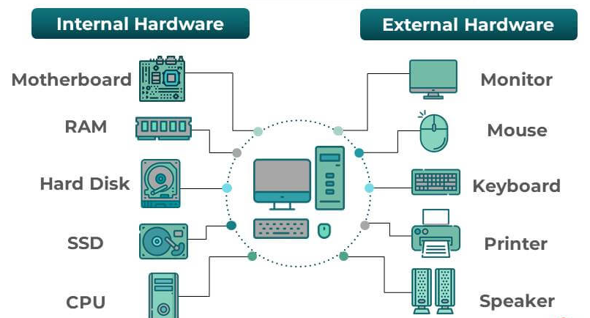
Module 1: Computer Hardware Basics
What is Hardware?
Hardware refers to the physical parts of a computer that you can see and touch:
Internal Hardware: The components inside the computer case that make it work.
External Hardware: The devices outside the computer that you plug in to use it.

Slide 8
Module 1: Computer Hardware Basics
Key Internal Components
CPU (Central Processing Unit): The "brain" of the computer. It performs all the calculations and processing.
RAM (Random Access Memory): The computer's short-term memory. It holds the data for the applications you are actively using. More RAM means you can run more programs at once smoothly.
Hard Drive (HDD or SSD): The computer's long-term storage. This is where your files, applications, and the operating system are saved, even when you turn the computer off. (SSDs are much faster than traditional HDDs).
Motherboard: The main circuit board that connects all the internal components.

Slide 9
Module 1: Computer Hardware Basics
Key External Components
Peripheral | What It Does | Common Port
Monitor | Displays the visual information. | HDMI (common digital), VGA (older)
Keyboard | Used to type information. | USB-A (the classic rectangle)
Mouse | Used to move the cursor and interact. | USB-A
Headset | Used for audio calls, meetings, and listening. | Audio Jack (small circle) or USB-A
Printer | Prints documents. | USB-A or Wi-Fi (network)

Slide 10
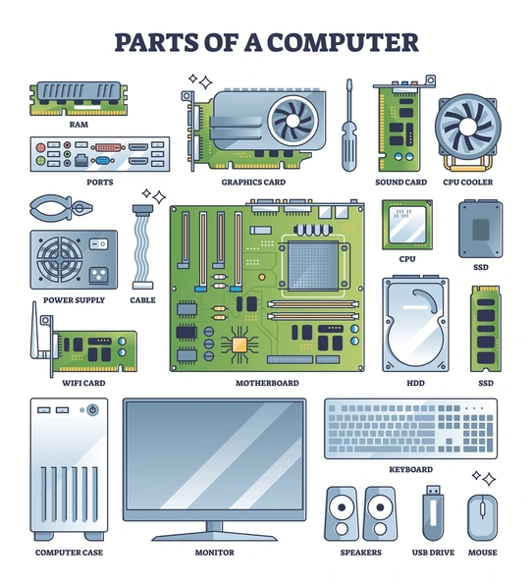
Module 1: Computer Hardware Basics
Basic Troubleshooting Steps
Before you call IT, try these simple steps. This solves a surprising number of issues!
"Have you tried turning it off and on again?" A full restart (not just "Sleep") clears the computer's temporary memory (RAM) and fixes many small glitches.
Check Your Cables: Is the monitor cable plugged in securely at both ends? Is the keyboard's USB plug all the way in?
Check the Power: Is the power strip turned on? Is the laptop's charging cable plugged in?

Slide 11

Module 1: Computer Hardware Basics
Quick Discussion
Let's talk about this for a minute:
When your computer monitor suddenly goes black, what's the first thing you should check?
When we talk about "RAM" vs. "Storage," what's the real-world difference for your daily work?
Who is responsible for making sure your keyboard and mouse are plugged in correctly each morning?
Have you ever solved a "big" computer problem with a very simple fix (like a restart)?

Slide 12
Module 2:
Using Outlook Effectively

Slide 13

Module 2: Using Outlook
The Anatomy of a Professional Email
Clear, Concise Subject Line: This is the most important part!
Bad: Update
Good: Project X: Update on Task 1 - Ready for Review
Good: Question: Deadline for Training Budget

Slide 14

Module 2: Using Outlook
The Anatomy of a Professional Email
Professional Greeting
Standard: “Hi [Name],”
Formal: “Dear [Name],”

Slide 15

Module 2: Using Outlook
The Anatomy of a Professional Email
Concise Body
Purpose: State why you are writing in the first sentence. ("I'm writing to request...")
Details: Provide the necessary background information.
Action: Clearly state what you need from the receiver. ("Please let me know your availability for a 15-minute call.")

Slide 16

Module 2: Using Outlook
The Anatomy of a Professional Email
Polite Closing & Signature
Standard: “Best regards,” “Thanks,” or “Thank you,”
Followed by your name and company signature.

Slide 17
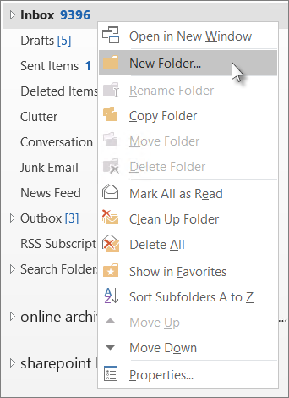
Module 2: Using Outlook
Inbox Organization
Use Folders: Create folders for different projects, departments, or topics. Move emails out of your inbox once you've dealt with them.
Flag for Follow-Up: If you can't respond right away, use the "Flag" feature to create a to-do item.
Delete What You Don't Need: Don't be afraid to delete old marketing emails or newsletters.

Slide 18

Module 2: Using Outlook
Calendar Management
Schedule Meetings: When you create a new "Appointment" or "Meeting," add attendees, a clear title, and a brief agenda in the body.
Respond to Invites: When you receive an invite, respond promptly with Accept, Tentative, or Decline so the organizer knows if you can make it.
Block Your Time: You can create appointments for yourself (e.g., "Focus Time: Work on Report") to block off time and prevent others from scheduling over it.

Slide 19
Module 3:
Word for Professionals

Slide 20

Module 3: Word for Professionals
Using Styles for Consistent Formatting
Stop manually changing font sizes and making things bold! Use the Styles pane on the Home tab.
Normal: This is the default style for all your body paragraphs.
Heading 1: Use this for your main document title.
Heading 2: Use this for your main section titles
(like "Module 3: Word for Professionals" in this document).
Heading 3: Use for sub-sections.

Slide 21

Module 3: Word for Professionals
Using Styles for Consistent Formatting
Why use styles?
If you decide you want all "Heading 2" titles to be blue, you just modify the style once, and every "Heading 2" in your entire document updates automatically. It also lets Word build an automatic Table of Contents for you.

Slide 22
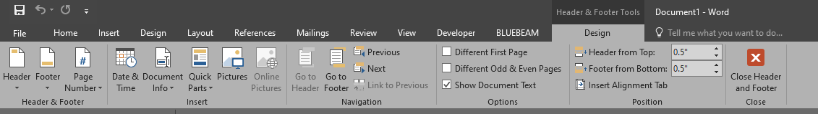
Module 3: Word for Professionals
Headers & Footers
This is the area at the very top (header) and bottom (footer) of each page.
Go to Insert > Header (or Footer).
Use this for information that should be on every page:
Page Numbers
Document Title
"Confidential" stamp

Slide 23
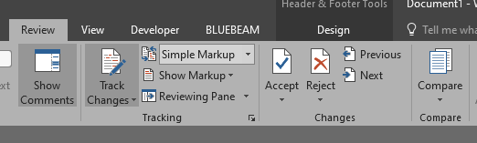
Module 3: Word for Professionals
Track Changes for Collaboration
When you need to edit someone else's document or have someone review yours, use Track Changes.
Go to the Review tab and click Track Changes.
Now, any change you make (deleting text, adding text, formatting) will be recorded as a "suggestion" in a different color.
The original author can then review your changes and Accept or Reject each one.
This is essential for professional collaboration. Never just start deleting and re-writing someone's work without it.

Slide 24
Module 3: Word for Professionals
Open Discussion
Why is using "Styles" better than just making text bold or larger by hand?
Have you ever been in a situation where "Track Changes" would have been useful?

Slide 25
Test your Knowledge
Again!
Please scan the QR code here or go to the below website:
https://afathelbab.github.io/cnpc/computer-basics-soft-skills/day2/quiz.html

Slide 26



A Better You, A Better Niger
74

Slide 27
Backup Slides

Slide 28
Workshop

Slide 29


Workshop
https://afathelbab.github.io/cnpc/computer-basics-soft-skills/workshops/

